Slide 1

Databases

Slide 2
SQL - Structured Query Language

Slide 3
Database Management Systems (DBMS)
Relational Database Management System (RDBMS)
NoSQL

Slide 4
Relational Database Management Systems
Oracle database
PostgreSQL
MySQL
Microsoft SQL Server
SQLite
H2

Slide 5
NoSQL
Storage types
Column-oriented
  Apache Cassandra
Document Store
  MongoDB
Key Value Store
  Redis
Graph
  NEO4J

Slide 6
DDL - Data Definition Language
CREATE / ALTER / DROP / TRUNCATE
DML - Data Manipulation Language
INSERT / UPDATE / DELETE
DQL - Data Query Language
SELECT
DCL - Data Control Language
Grant / Reverk
TCL - Transaction Control Language
Commit / Rollback

Slide 7

Let’s experiment

Slide 8
DDL
CREATE DATABASE Db
DROP DATABASE Db
USE Db
CREATE TABLE Students(
Id int,
Name nvarchar(50),
Surname nvarchar(100)
)
DROP TABLE Students
ALTER TABLE Students
ADD Age int,City nvarchar(50)
ALTER TABLE Students
DROP COLUMN Age
EXEC sp_rename Stu,Students
EXEC sp_rename 'Students.Surname',Lastname

Slide 9
DML
INSERT INTO Students
VALUES(1,'Orkhan','Abdullayev',24,'Sumqayit'),
(2,'Test','Testov',24,'Baki'),
(4,'Orkhan','Abdullayev',24,'Sumqayit')
INSERT INTO Students (Id,Name,Lastname)
VALUES(2,'Agha','Dadash')
SELECT * FROM Students WHERE Lastname LIKE '%la%'
SELECT Id 'Number',Name 'Firstname' FROM Students
UPDATE Students SET Lastname='Main Hesenli' Where Id=2
DELETE FROM Students WHERE Id=2

Slide 10
SQL Constraints
NOT NULL - Ensures that a column cannot have a NULL value
UNIQUE - Ensures that all values in a column are different
PRIMARY KEY - A combination of a NOT NULL and UNIQUE. Uniquely identifies each row in a table
FOREIGN KEY - Prevents actions that would destroy links between tables
CHECK - Ensures that the values in a column satisfies a specific condition
DEFAULT - Sets a default value for a column if no value is specified
Notes:
CREATE TABLE Students(
Id int identity primary key,
Name nvarchar(100) not null,
Surname nvarchar(100),
Age int check(Age<100),
Email nvarchar(255) unique
)
Some function:
SELECT LEN(Name) 'Length',Name FROM Students
SELECT CHARINDEX('@',Email),Email FROM Students
SELECT SUBSTRING(Email,1,3),Email FROM Students
SELECT SUBSTRING(Email,1,CHARINDEX('@',Email)-1),Email FROM Students
SELECT SUBSTRING(Email,CHARINDEX('@',Email)+1,LEN(Email)),Email FROM Students
SELECT SUM(AGE) FROM Students
SELECT AVG(AGE) FROM Students
SELECT MIN(AGE) FROM Students
SELECT MAX(AGE) FROM Students

Slide 11
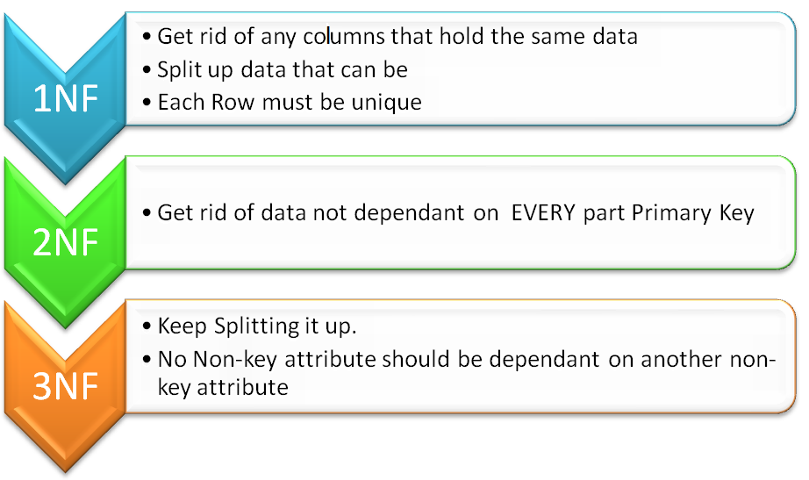
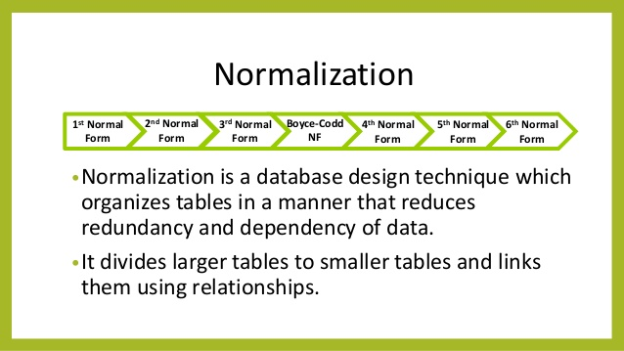
Normal Forms in DBMS

Slide 12
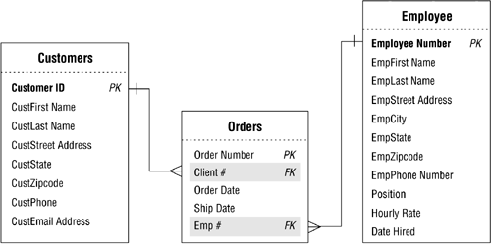
PK - Primary key
FK - Foreign key

Slide 13
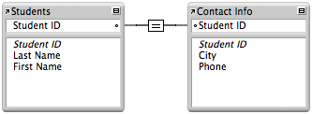
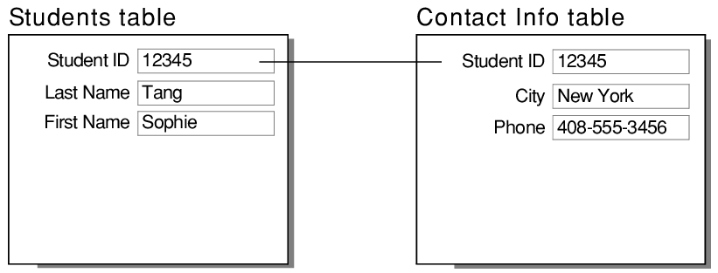
One-to-one
One record in a table is associated with one and only one record in another table.

Slide 14
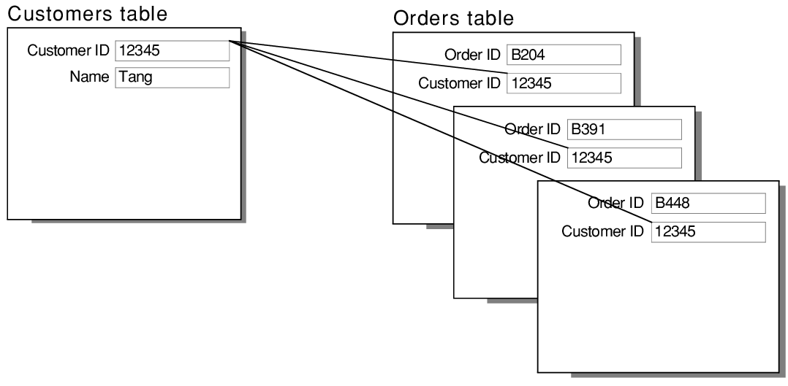
One-to-many
One record in a table can be associated with one or more records in another table.

Slide 15
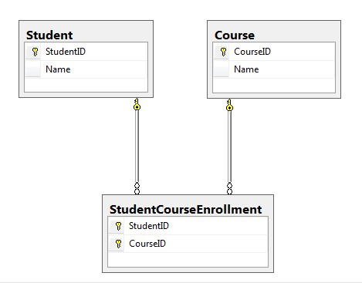
Many-to-many
Multiple records in a table are associated with multiple records in another table

Slide 16
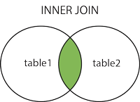
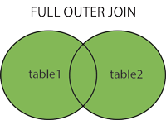
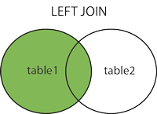
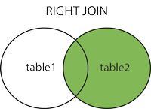
Notes:
--inner join
SELECT CityName 'City',
ct.Population 'City Population',
CountryName 'Country',
c.Population 'Country Population'
FROM Cities ct JOIN Countries c
ON
ct.CountryId=c.Id
--LEFT OUTER JOIN
SELECT CityName 'City',
ct.Population 'City Population',
CountryName 'Country',
c.Population 'Country Population'
FROM Cities ct LEFT JOIN Countries c
ON
ct.CountryId=c.Id
--RIGHT OUTER JOIN
SELECT CityName 'City',
ct.Population 'City Population',
CountryName 'Country',
c.Population 'Country Population'
FROM Cities ct RIGHT JOIN Countries c
ON
ct.CountryId=c.Id
--FULL OUTER JOIN
SELECT CityName 'City',
ct.Population 'City Population',
CountryName 'Country',
c.Population 'Country Population'
FROM Cities ct FULL JOIN Countries c
ON
ct.CountryId=c.Id
--SELF JOIN
CREATE TABLE Ranks(
Id int identity primary key,
Position nvarchar(255) not null,
Dependency int
)
SELECT r1.Position,r2.Position 'Dependency' FROM Ranks r1
LEFT JOIN Ranks r2
ON
r1.Dependency=r2.Id
--NON-EQUAL JOIN
ALTER TABLE Students
ADD Score int
CREATE TABLE Grades(
Id int identity primary key,
MinGrade int,
MaxGrade int,
Letter nchar
)
SELECT Name,Surname,Age,Email,Score,Letter FROM Students st
JOIN Grades g
ON
st.Score BETWEEN g.MinGrade AND g.MaxGrade
--cross join
CREATE TABLE Products(
Id int identity primary key,
Name nvarchar(100) not null
)
CREATE TABLE Sizes(
Id int identity primary key,
Size nvarchar(10) not null
)
SELECT Name 'Product',Size FROM Products
CROSS JOIN Sizes
--query
CREATE TABLE GroupTypes(
Id int identity primary key,
Name nvarchar(100) not null
)
CREATE TABLE Groups(
Id int identity primary key,
Name nvarchar(100) not null,
GroupTypeId int references GroupTypes(Id)
)
CREATE TABLE StudentGroups(
Id int identity primary key,
GroupId int references Groups(Id),
StudentId int references Students(Id)
)

Slide 17
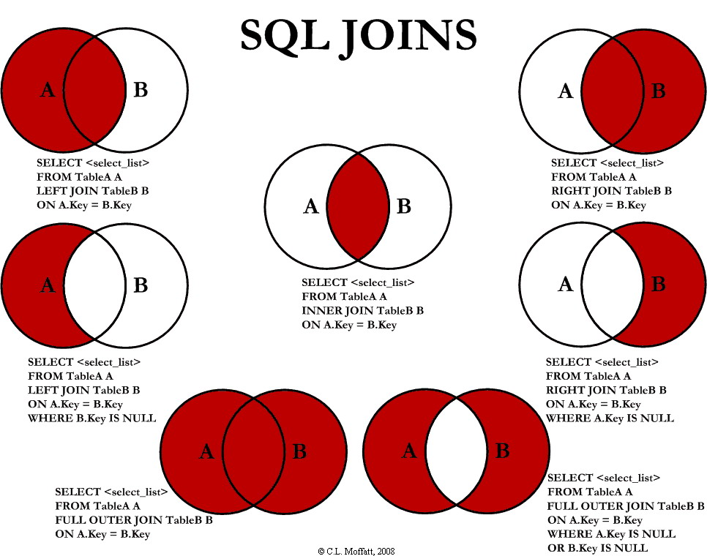
Notes:
Cons and pros,

Slide 18
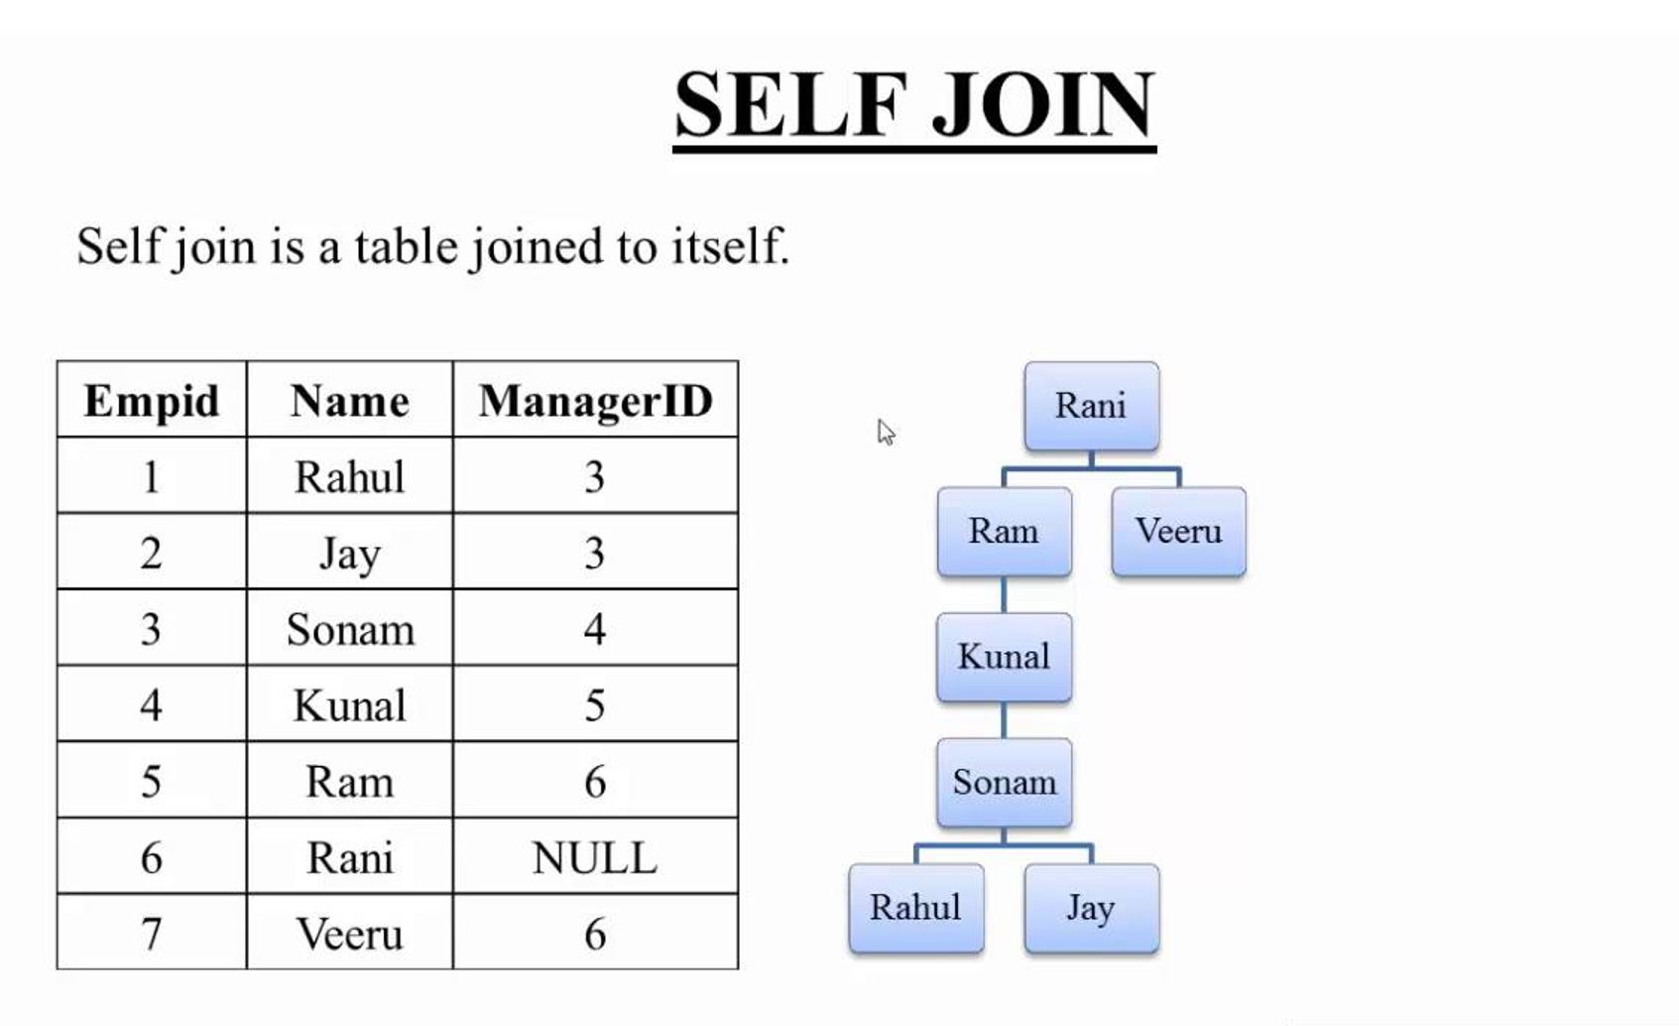
Notes:
Cons and pros,

Slide 19
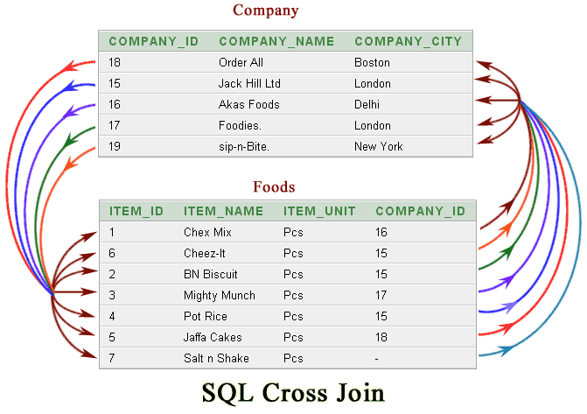
Notes:
Cons and pros,

Slide 20
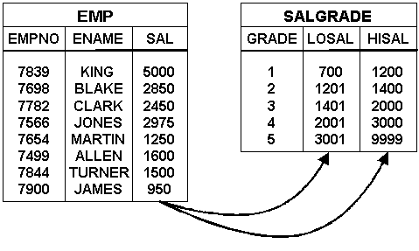
SQL non Equi Join
The SQL non Equi Join use comparison operator instead of equal sign
like >, <, <=, >= along with conditions.

